Slide 1
Mountain Bike Suspension 20FB14
Erik Abraham, Suliman Alsinan, Austin Coyne, Jacob Cryder, Dylan Klemp, Tyson Spencer

Slide 2
Problem Statement
Mountain bike suspension lacks the capabilities to quickly and easily adjust for different terrain on the fly and needs to have a tuning option to allow for a more comprehensive system. Mountain bike suspension can be adjusted but can sometimes be difficult to understand for the average consumer. So, the team needs to create an easier way to help even beginner mountain bikers be able to alter their suspension settings.

Slide 3
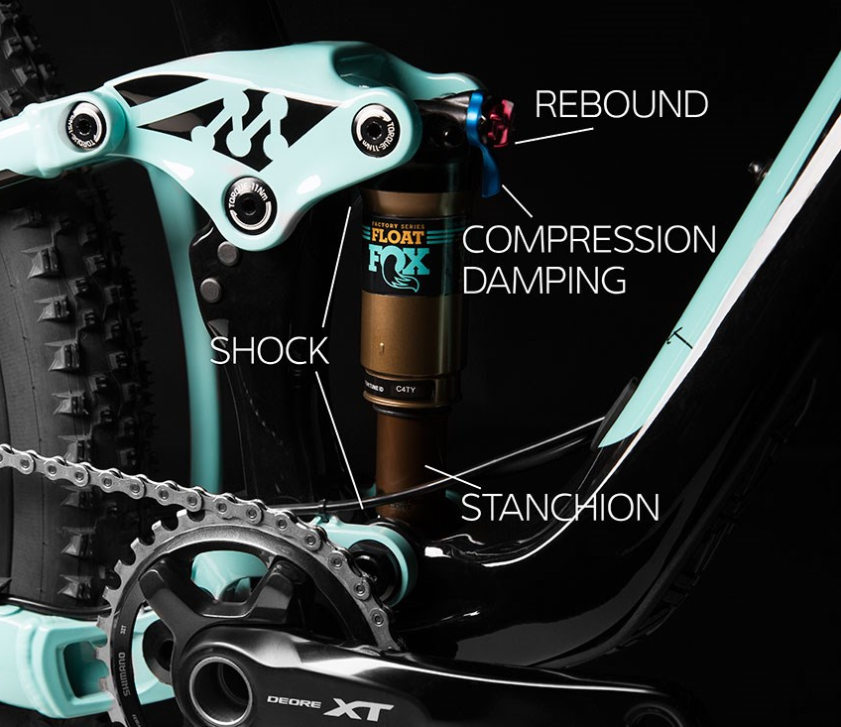
Project Description
Create a mathematical model to optimize damping in full suspension mountain bikes over various terrains
Analyze mathematical model with physical testing of a shock and mountain bike
Develop an easy to use, suspension tuning device that allows for mountain bikers to adjust their suspension on the trail
[1]
Notes:
Mountain bikes are widely used by both professional and casual riders, which results in knowledge gaps concerning the mechanics of bikes and how to optimize their performance for various terrain types.
This prevents the casual riders from adjusting their own suspension, causing them to seek help at local bike shops. Suspension settings should be continuously adjusted based on the trail the rider is currently on, leading the team to arrive at the idea for this project.

Slide 4
Black Box Model
Adjust
MTB
Suspension
Combined Bike/Rider Weight
Bike/Rider Weight
Terrain Impacts
Suspension Reactions
Current Adjustments
Modified Adjustments

Slide 5
Concept Generations
Team Member | Sub-function | Description
Jake Cryder | Stress Analysis | Analyzing stresses with applied loads.
Tyson Spencer | Terrain Analysis | Analyze and classify terrain types in relation to suspension properties

Slide 6
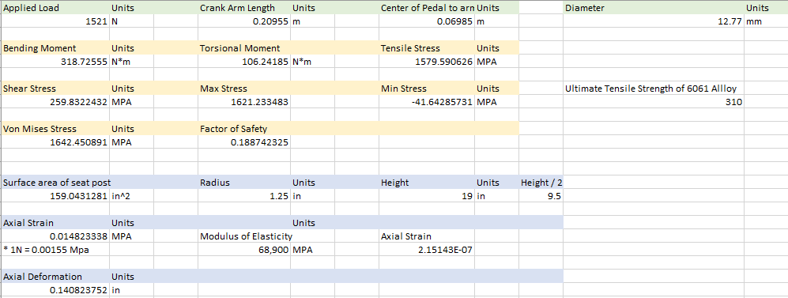
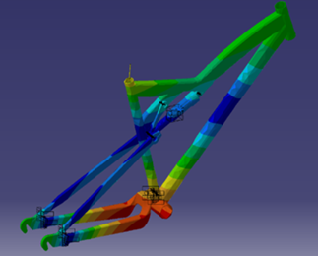
Stress Analysis
SolidWorks vs. Excel
Advantages vs. Disadvantages
Figure 1: Excel Von Mises Calculation
Figure 2: CAD SolidWorks Von Mises Stresses

Slide 7
Terrain Analysis
IMBA Trail Difficulty Ratings [4] | White Circle | Green Circle | Blue Square | Black Diamond | Double Black Diamond
Tread Surface | Hardened & Surfaced | Firm & Stable | Mostly Stable Variable | Widely Variable | Variable & Unpredictable
Average Grade | < 5% | ≤ 5% | ≤ 10% | ≤ 15% | ≤ 20%
Maximum Grade | 10% | 15% | ≥ 15% | ≥ 15% | ≥ 15%
Trail Width | 72"+ | 36"+ | 24"+ | 12"+ | 6"+
Obstacles and TTFs | None | ≤ 2" Tall | ≤ 8" Tall TTFs ≤ 2" Tall | ≤ 15" Tall TTFs ≤ 4" Tall | ≥ 15" Tall TTFs ≥ 4" Tall
Governing Equations for Mathematical Model:
(1) my'' + cy' + ky = F(t) (2) F(t) = d(t - c)

Slide 8
Concept Evaluation
Stress Analysis
Solid Works focus, utilizing excel to support calculations and analysis
Terrain Analysis
Utilize Linkage X3 to then apply values into MATLAB code

Slide 9
Budget Planning
Bill of Materials (Tentative)
Item | Quantity | Cost
Linkage X3 Software | 1 | $300
Rear Shock | 1 | $300
Full Suspension Bike | 1 | $1200 Max
Arduino Kit | 1 | $65
Arduino Sensors | 1 | $35
Total Budget | $2000-$3000 | $1900

Slide 10
Sources Cited
[1] Liv. https://www.liv-cycling.com/global/campaigns/how-to-set-up-mountain-bike-suspension/20654. Accessed: 18 September 2020
[2] Fox. Live Valve. https://www.ridefox.com/content.php?c=livevalve-bike. Accessed: 18 September 2020
[3] “Free CAD Designs, Files & 3D Models: The GrabCAD Community Library,” Free CAD Designs, Files & 3D Models | The GrabCAD Community Library. [Online]. Available: https://grabcad.com/library/enduro-mountain-bike-frame-1. [Accessed: 14-Oct-2020].
[4] International Mountain Bicycling Association. Trail Difficulty Rating System. https://www.imba.com/sites/default/files/content/resources/2018-10/IMBATrailDifficultRatingSystem.jpg. Accessed: 14 September 2020

